Slide 1
COMP6049 – Algorithm Design and Analysis
Topic 20 – Basic Search and Traversal

Slide 2
Outline Materials
Tree traversal
Depth First Search
Breadth First Search
DFS and BFS in Tree
DFS and BFS in Graph

Slide 3
REVIEW TREE TRAVERSAL
Traversal is a process to visit each node in a tree.
Pre-order Traversal
parent–left–right
Level-order Traversal
parent–left–right
In-order Traversal
left–parent–right (this technique is only for Binary Tree)
Post-order Traversal
left–right–parent

Slide 4
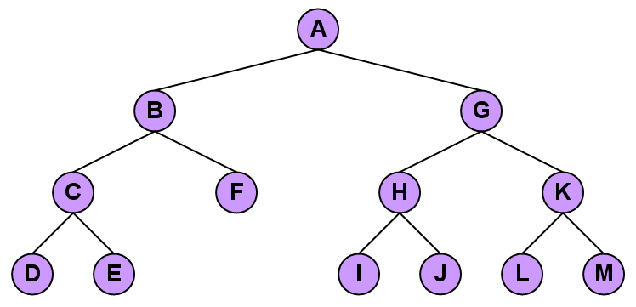
PRE-ORDER TRAVERSAL

Slide 5
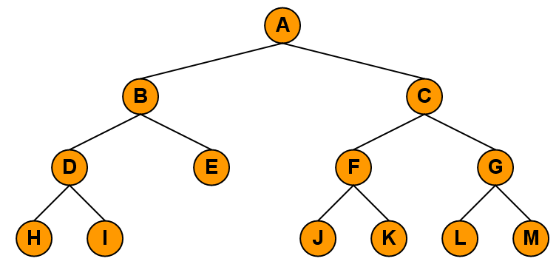
LEVEL-ORDER TRAVERSAL

Slide 6
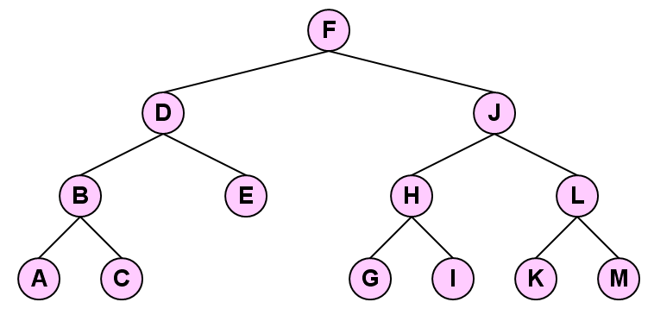
IN-ORDER TRAVERSAL

Slide 7
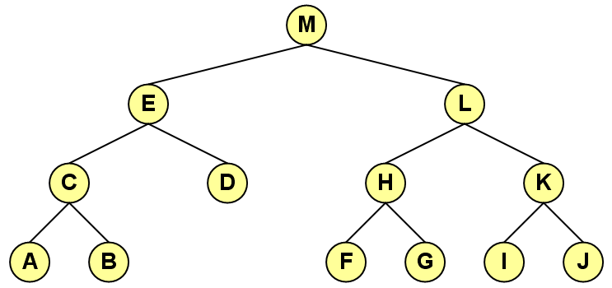
POST-ORDER TRAVERSAL

Slide 8
IMPLEMENTATION OF TREE DFS
Steps:
Set status to 1 (white color) to all nodes
Enter root node to a stack, set status to 2 (orange color)
Take top of the stack, set status to 3 (green color)
Enter left child and right child to the stack, set status to 2 (orange color)
Repeat step 3 until the stack is empty or searched data is found
Steps in the more "technical" term:
PUSH root node
POP node X dari stack
PUSH all children of node X to the stack
Repeat step 2

Slide 9
TREE DFS (1)
A
B
E
C
D
F
G

Slide 10
TREE DFS (2)
A
B
E
C
D
F
G
A
Stack

Slide 11
TREE DFS (3)
A
B
E
C
D
F
G
A
Stack

Slide 12
TREE DFS (4)
A
B
E
B
C
D
F
G
E
A
Stack

Slide 13
TREE DFS (5)
A
B
E
C
D
F
G
E
A
B
Stack

Slide 14
TREE DFS (6)
A
B
E
C
D
C
D
F
G
E
A
B
Stack

Slide 15
TREE DFS (7)
A
B
E
D
C
D
F
G
E
A
B
C
Stack

Slide 16
TREE DFS (8)
A
B
E
C
D
F
G
E
A
B
C
D
Stack

Slide 17
TREE DFS (9)
A
B
E
C
D
F
G
A
B
C
D
E
Stack

Slide 18
TREE DFS (10)
A
B
E
F
C
D
F
G
G
A
B
C
D
E
Stack

Slide 19
TREE DFS (11)
A
B
E
C
D
F
G
G
A
B
C
D
E
F
Stack

Slide 20
TREE DFS (12)
A
B
E
C
D
F
G
A
B
C
D
E
F
G
Stack

Slide 21
IMPLEMENTATION OF TREE BFS
Steps:
Set status to 1 (white color) to all nodes
Enter root node to a queue, set status to 2 (orange color)
Take the front of queue (bottom position), set status to 3 (green color)
Enter left child and right child to the queue, set status to 2
Repeat step 3 until queue is empty or searched data is found.
Steps in the more "technical" term:
PUSH root node a queue
POP node X from queue
PUSH all childrent of node X to the queue
Repeat step 2.

Slide 22
TREE BFS (1)
A
B
E
C
D
F
G

Slide 23
TREE BFS (2)
A
Queue
B
E
C
D
F
G
A

Slide 24
TREE BFS (3)
A
Queue
B
E
C
D
F
G
A

Slide 25
TREE BFS (4)
A
Queue
B
E
E
C
D
F
G
B
A

Slide 26
TREE BFS (5)
A
Queue
B
E
C
D
F
G
E
A
B

Slide 27
TREE BFS (6)
A
Queue
B
E
D
C
C
D
F
G
E
A
B

Slide 28
TREE BFS (7)
A
Queue
B
E
D
C
D
F
G
C
A
B
E

Slide 29
TREE BFS (8)
A
G
Queue
B
E
F
D
C
D
F
G
C
A
B
E

Slide 30
TREE BFS (9)
A
Queue
B
E
G
F
C
D
F
G
D
A
B
E
C

Slide 31
TREE BFS (10)
A
Queue
B
E
G
C
D
F
G
F
A
B
E
C
D

Slide 32
TREE BFS (11)
A
Queue
B
E
C
D
F
G
G
A
B
E
C
D
F

Slide 33
TREE BFS (12)
A
Queue
B
E
C
D
F
G
A
B
E
C
D
F
G

Slide 34
IMPLEMENTATION OF GRAPH DFS
Steps:
Represent graph in Adjacency List
Set all nodes status to 1
Enter the beginning node to stack, set status to 2
Take top of the stack, set status to 3
Enter node yang adjacent dengan yang baru diambil yang status 1 ke stack, set status to 2
Repeat steps above until the stack is empty or searched data is found.

Slide 35
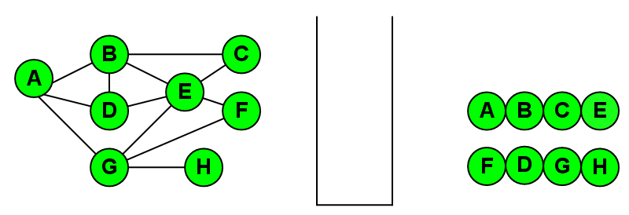
RESULTS OF DFS

Slide 36
IMPLEMENTATION OF GRAPH BFS
Steps:
Represent graph with the adjacency list
Set all nodes status 1
Enter the initial node to the queue, set the status to 2
Take a leading queue, set the status to 3
Enter the node adjacent to the newly drawn to the status of a queue, set the status to 2
Repeat the steps above until the queue is empty or the data sought is found

Slide 37
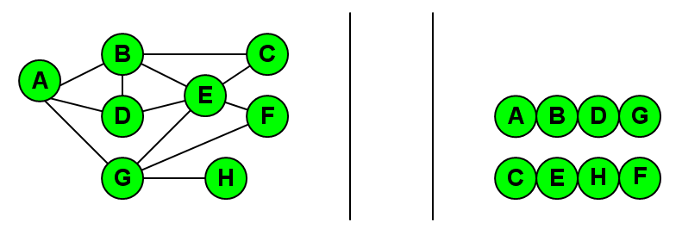
RESULTS OF BFS

Slide 38
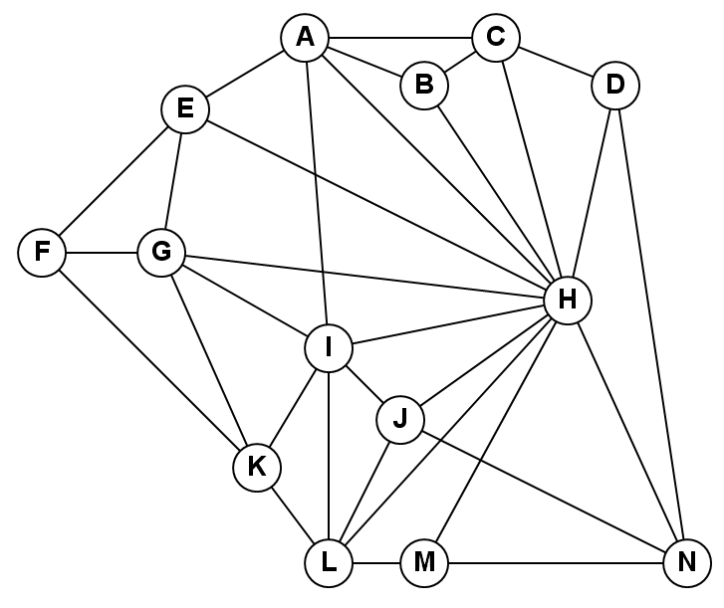
EXERCISE
Do implementation of DFS and BFS for the following graph:

Slide 39
REVIEW
Review tree traversal
Implementation of tree DFS
Implementation of tree BFS
Implementation of graph DFS
Implementation of graph BFS

Slide 40
Q & A

Slide 41
References
Thomas H. Cormen. 2009. Introduction to algorithms. TMP. London. ISBN:9780262033848. Chapter 22
Breadth first search and depth first search
https://www.ics.uci.edu/~eppstein/161/960215.html

Slide 42
THANK YOU

